Slide 1

L.A.S.T. (Linux Apache Subversion Trac)
Version Control and Project Management for Workgroups
Scott Grizzard
scott@scottgrizzard.net
http://www.scottgrizzard.net

Slide 2
Goals

Slide 3
Why Subversion?
Easy to Setup and Administer
Easy to Integrate into Network
Client-Server
Graphical Clients
IDE Integration
Many group-oriented features not found in other VCS's
Widely Used

Slide 4
Why Subversion Over <X>
Easy to Setup/Administer and Integrate
Subversion Uses Apache
  Installation is Very Similar to standard LAMP Server
  Can use Any Apache Authentication Module
    Including Kerberos, NTLM, LDAP, and SQL
  Traffic wrapped in SSL
    No need for VPN
SVN and Trac in Debian/Ubuntu Repositories
Simple commands to back-up repositories
  Supporting both incremental and full backups
  Changes can even be emailed

Slide 5
Why Subversion Over <X>
Client-server vs Distributed
Distributed version control, such as Bazaar, Git, and Mercurial, allow each user to maintain his own complete branch of the software.
  This is excellent for Open Source projects, promoting forking and independent development.
  Maintaining the various branches, and merging them, becomes an administrative nightmare for controlled projects.
Client-server version control, such as Subversion, is easier to use and manage.
Notes:
Add Image of Distributed vs Client Server from BZR website.

Slide 6
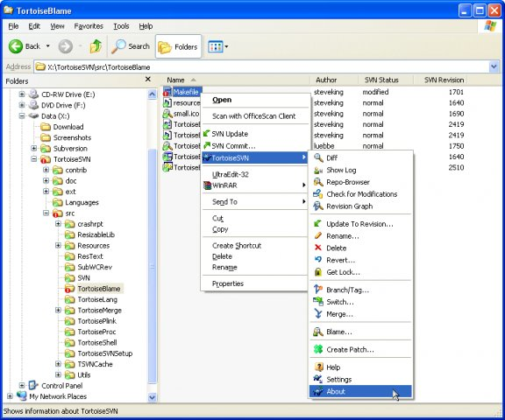
Why Subversion Over <X>:
Graphical Clients
Excellent Graphical Clients for Big Three OS's
  TortoiseSVN for Windows
  SCPlugin on MacOS X
  RabbitVC on Gnome
  KDE-SVN for KDE 3 and 4
TortoiseSVN on Windows XP
Notes:
TortoiseSVN is the Gold Standard by which other graphical clients are judged.
Easy
Fast
SCPlugin has a few issues
RabbitVC is a new GoogleCode project
Plugin for Nautilus
KDESVN is integrated with Konqueror
Worked very well in KDE 3.5
Works alright in KDE4
Don't know what the status is with Dolphin integration

Slide 7
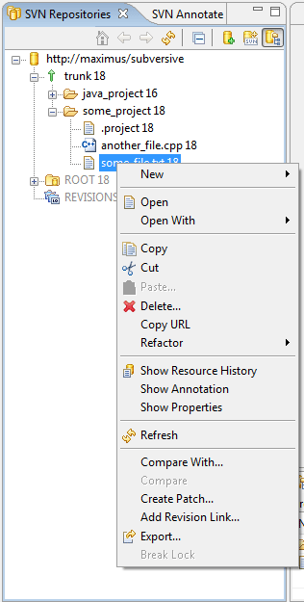
Why Subversion Over <X>:
IDE Integration
Subversion Integrates well with Popular IDE's
  Eclipse: The Subclipse Plugin & Subversive Plugin
  X-Code: Native Support
  Visual Studio: Open Source AnkhSVN plugin; Proprietary VisualSVN
  Dreamweaver: Native Support in CS4 & CS5
  Plugins for Notepad++ and Vim
Subversive in Eclipse
Notes:
Image is of Subversive in Eclipse...taken from Subversive website.

Slide 8
Why Subversion Over <X>:
Workgroup Features
File Locks
Fine-Grained Authorization
  Allows Public Access to Parts of Repository
Reports
Blame
Integrity
  Committers do not need write access to database files
    Users with Commit Permissions Cannot alter past Transactions
    Users with Commit Permissions Cannot delete the Database
Transparent Access over WebDav
Pre-Commit and Post-Commit Scripting

Slide 9
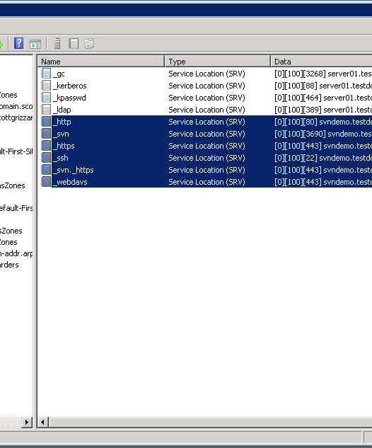
Configure Domain Controller
Add DNS Entries
  Add reverse zone for Orange if needed.
  Add A record for new server
  Add CNAME for intranet if different than A (Not Recommended)
  (Optional) Add SRV records for HTTP, HTTPS, and SVN
Create Group Policy, adding SVN server to local intranet zone, and create a bookmark in IE.
and...that's it...
Notes:
DNS Configured Screenshot goes here
DNS SRV records primarily for Bonjour and other network browsers, to point them to services.
If you want to use LDAP, you need to configure Certificate Services so your system has an LDAPs connection, and you need to configure AD to accept LDAP connections over ssl.
Also need to create an AD principle to read the LDAP entries, and you need to create the appropriate permissions.

Slide 10
Configure the Firewall
Red to Yellow
  HTTP (80/TCP)
  HTTPs (443/TCP)
  Close all Others
Yellow to Red
  SMTP (25/TCP if using mail)
  HTTP (80/TCP for APT)
Yellow to Green Server
  DNS (53/UDP/TCP)
  Kerberos (88/UDP/TCP)
  Samba (445/TCP/UDP)
  NTP (123/UDP)
Green to Yellow
  SSH (22/TCP)
  Kerberos
  HTTP & HTTPS
  Samba

Slide 11
Why Ubuntu LTS?
Easy to Install
Trac and Subversion in Repositories
Latest version of Samba, containing new AD integration tools
Good, solid enterprise operating system.
Notes:
Joke about sticking the cd upside down in a 5 1/4” disk drive and it installing...

Slide 12
Install Ubuntu 10.04 LTS
Hardware Recommendations:
  Something with a 1.0GHz processor, 512M RAM, and Gigabit networking.
  Two IDENTICAL hard drives
Insert CD, and choose all the default options except:
  When you configure the network, try to use the same name that you intend the server to have from the outside...i.e., svn.testdomain.scottgrizzard.com
  Use localadmin as the username
  Do not configure any additional services for this server
  Do not configure automatic updates
Notes:
Hardware recommendations...the point is to use RAID 1.
The server name being identical flys in the face of networking 101...but Mac clients like srv records in DNS.

Slide 13
Configure Ubuntu System
Install etckeeper to keep track of configurations
  sudo apt-get install etckeeper
  sudo etckeeper init
Configrue Static IP Address if Needed according to http://www.howtogeek.com/howto/ubuntu/change-ubuntu-server-from-dhcp-to-a-static-ip-address/
  Note: dhcp-client now called dhcp3-client
Install ssh-server for remote access.
  sudo apt-get install openssh-server
Install updates and reboot
  sudo apt-get update
  sudo apt-get upgrade
  sudo apt-get install linux-headers-server linux-image-server linux-server
  sudo reboot
You can now log-in to the server remotely using an SSH client such as PuTTY or the Mac command line.

Slide 14
Add Server to Domain:
Install NTP
Kerberos requires time to be kept in sync
Install ntp to keep time in sync with Domain Controller
  Make sure the PDC can serve time to this computer.
    sudo ntpdate server01.testdomain.scottgrizzard.com
  sudo apt-get install ntp
    Change the /etc/ntp.conf file, changing server ntp.ubuntu.com to server01.testdomain.scottgrizzard.com (sudo vi /etc/ntp.conf)
    Commit config change to server with sudo etckeeper commit –m “changed ntp server”
  Restart the ntp server
    sudo /etc/init.d/ntp restart

Slide 15
What is Kerberos?
The Kerberos Protocol forms the foundation of Active Directory Authentication
Allows Single Sign On (SSO) for domain members, allowing them to only enter their password once (when they log-in), giving the user credentials for all Kerberosized services on the network.
Very Secure, and prevents users from needing to store passwords.
Implementations include MIT Kerberos (the original), Heimdal, and Active Directory.
MIT and Heimdal Clients can use a Windows KDC (but the inverse is not true).
Kerberos REQUIRES Time on the servers to Be in Sync

Slide 16
Add Server to Domain:
Install and Configure Kerberos
Install Kerberos Clients
  sudo apt-get install krb5-config krb5-clients krb5-doc krb5-user
  if everything is set up properly, running kinit Adminstrator should prompt you for your password.
(Optional) Configure server to not need DNS for Kerberos
  To keep the server from polling DNS for every login, put the information into /etc/krb5.conf and /etc/hosts as pointed out on http://ubuntuforums.org/showthread.php?t=280702

Slide 17
Add Server to Domain
Install and Configure Winbind
Sudo apt-get install winbind
Sudo vim /etc/samba/smb.conf
  [global]
  workgroup = TESTDOMAIN
  server string = %h server (Samba, Ubuntu)
  netbios name = svndemo
  realm = TESTDOMAIN.SCOTTGRIZZARD.COM
  security = ADS
  password server = server01.testdomain.scottgrizzard.com
  kerberos method = system keytab
Join the Domain!
  sudo net ads join –U Administrator
  Enter Administrator’s password:
  Using short domain name – TESTDOMAIN
  Joined ‘SVNDEMO’ to realm ‘testdomain.scottgrizzard.com’

Slide 18
Install Apache
sudo apt-get install apache2.2-bin apache2.2-common apache2-utils ssl-cert apache2-mpm-prefork
Try it in a web browser!
Configure ssl
  Consult openssl documentation to create CSR if you want to use a third-party certificate, or sign one using Active Directory
  If you are fine with the default, self-signed, ssl certificate, sudo a2enmod ssl
  Enable the default-ssl site
    sudo a2ensite default-ssl
  Restart Apache
    sudo /etc/init.d/apache2 restart
Test
Use mod-rewrite to redirect all requests to https://, and disable directory access to port 80.

Slide 19
Configure mod_auth_kerb
sudo apt-get install libapache2-mod-auth-kerb
Create a service principle for Apache in AD
  sudo net ads keytab add HTTP –U Administrator
Test with ktutil as shown on http://michele.pupazzo.org/diary/?p=460
Allow Apache2 to access the keytab:
  sudo chmod 740 /etc/krb5.keytab
  sudo chown :www-data /etc/krb5.keytab
Lock down /etc/apache2/sites-available/default-ssl with a global <Location> directive at the end:

Slide 20
Configure mod_auth_kerb (cont.)
<Location />
AuthType Kerberos
AuthName SVN Server
KrbMethodNegotiate On
KrbMethodK5Passwd On
KrbAuthRealms TESTDOMAIN.SCOTTGRIZZARD.COM
Krb5KeyTab /etc/krb5.keytab
Krb5AuthToLocal On
require valid-user
</Location>
Test

Slide 21
Install Subversion
Create Directories…
  Sudo mkdir /var/subversion
  Sudo chown www-data:www-data /var/subversion
Install subversion
  Sudo apt-get install subversion libapache2-svn
Create the first repository
  sudo svnadmin create /var/subversion/demo
  sudo chown www-data:www-data /var/subversion/demo –R

Slide 22
Configure Apache to Host SVN
Edit /etc/apache2/sites-available/default-ssl
  <Location /svn>
  DAV svn
  SVNParentPath /var/subversion
  SVNAutoversioning on
  #ModMimeUsePathInfo on
  SVNPathAuthz off
  SVNListParentPath on
  </Location>
Restart Apache and Check It Out!

Slide 23
Installing Trac
Sudo apt-get install trac
Create Trac Directories
  sudo mkdir /var/trac
  sudo chown www-data:www-data /var/trac
Configure Apache (default-ssl)
  <Location /trac>
  SetHandler mod_python
  PythonInterpreter main_interpreter
  PythonHandler trac.web.modpython_frontend
  PythonOption TracEnvParentDir /var/trac
  PythonOption TracUriRoot /trac
  PythonOption PYTHON_EGG_CACHE /tmp
  </Location>
Restart Apache

Slide 24
Create a Trac Project
sudo /var/trac/demo initenv demo
  On the interactive menu, name the project “demo”, accept the default database and Repository Type, and use /var/subversion/demo as your repository path
Give your user admin privs
  sudo trac-admin /var/trac/demo permission add sgrizzard trac-admin
Change ownership to www-data
  Sudo chown www-data:www-data /var/trac -R

